Slide 1
Introduction
EASYFLY
- Trần Bảo Huyền Trâm
- Bùi Tuấn Khải
- Ngô Thịnh Phát
- Lê Thị Trang
Date 16 Month 08 Year 2023

Slide 2
Content
Introduction
Actual requirements
Requirements of the project
Deployment diagram
Test result
Conclusion and development
Task list

Slide 3
Introduction - Actual requirements
The EasyFly Project is an ambitious endeavor aimed at revolutionizing the way individuals book their flights. In a world where travel is an integral part of modern life, EasyFly offers a user-centric flight booking platform that seamlessly combines convenience, choice, and reliability. This project seeks to create a transformative online space where travelers can effortlessly plan their journeys, from selecting flights to making secure payments.

Slide 4
Introduction - Requirements of the project
Functional
Users must be able to create accounts with unique usernames and passwords.
Secure user login functionality with session management.
Search feature enabling users to find flights based on departure, destination, dates, and preferences.
Users can view their booking history
Non-functional
Intuitive user interface catering to different tech levels.
Responsive design across devices.
Fast website loading (within 5 seconds).
Swift search query and result generation (within 5 seconds).
Notes:
Non-functional (how the system works)
Functional (what the system should do)

Slide 5
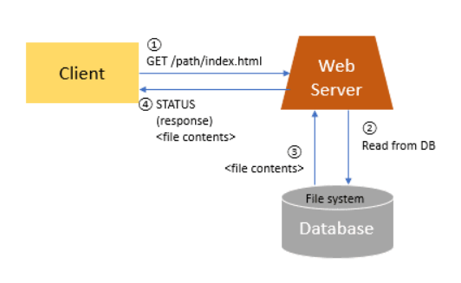
Introduction - Deployment diagram

Slide 6
Test Result [1-n]
Ticket management: The functions of search and select ticket status work correctly.
Booking management: The system allows customers to book and send booking information accurately and quickly.
Payment and Invoice Management: The system automatically generates invoices and records payments correctly
Easy to use: The system interface is designed to be clear, easy to understand and user-friendly.

Slide 7
Test Result [2-n]
Security: The system applies strong security measures to protect personal and business information from fraud and unauthorized access.
Security: The system applies strong security measures to protect personal and business information from fraud and unauthorized access.

Slide 8
Conclusion
In conclusion, the EasyFly booking ticket online system has met the requirement of the project
Important function system has good performance, easy to use and secure

Slide 9
Development
User interface enhancement: Upgrade the user interface to create a more user-friendly and convenient user experience.
New technology integration: Consider integrating technology such as artificial intelligence to optimize demand prediction and improve customer experience.

Slide 10
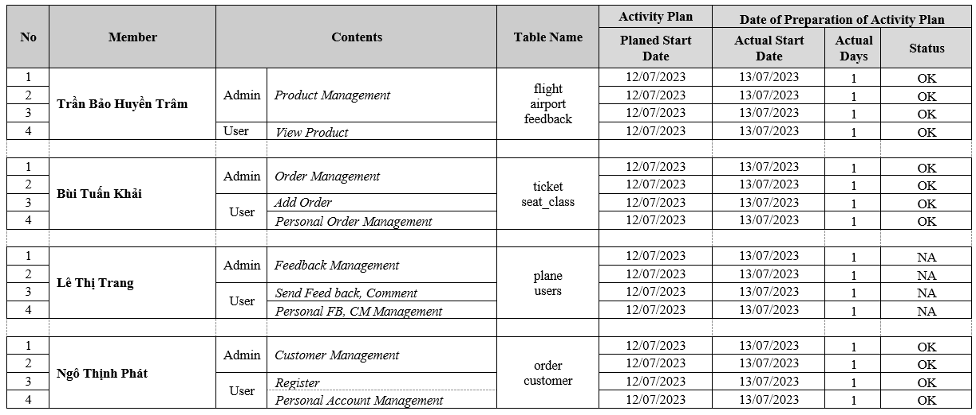
Task List

Slide 11

Thank You

Slide 12
Reference

